Slide 1


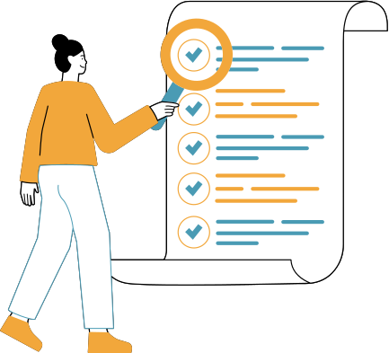
VAULT OF CODES FINAL TASK
TO-DO LIST APP

Slide 2

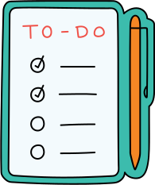
INTRODUCTION
I have made a to-do list app where the user can add new tasks everyday and delete them as required.
This do list app is made with Next.js , HTML and Tailwind CSS

Slide 3
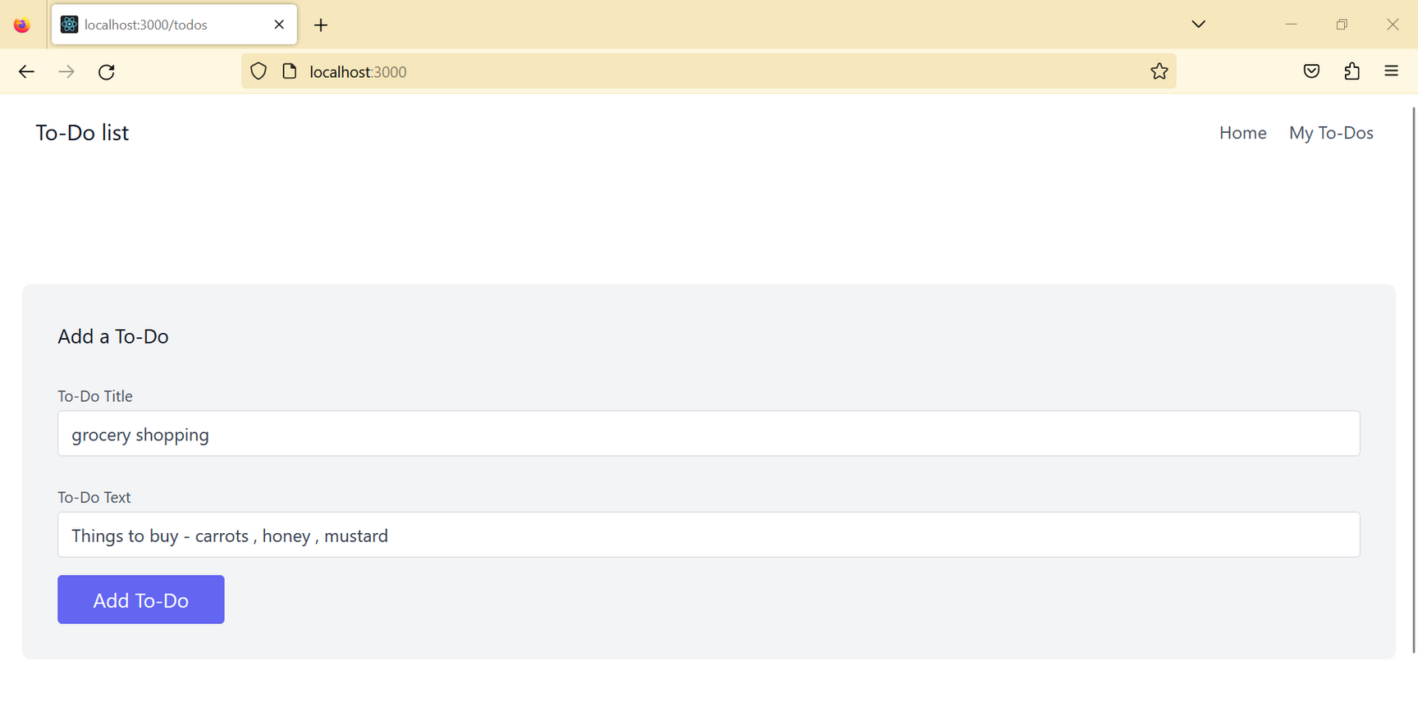
WORKING
The user can go to our to-do list app and can enter the title of the todo list i.e. what task they want to do and then add the description of the task
Once the user has entered the details they have to press on the “Add To-Do” button to save the to-do

Slide 4
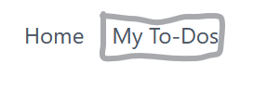
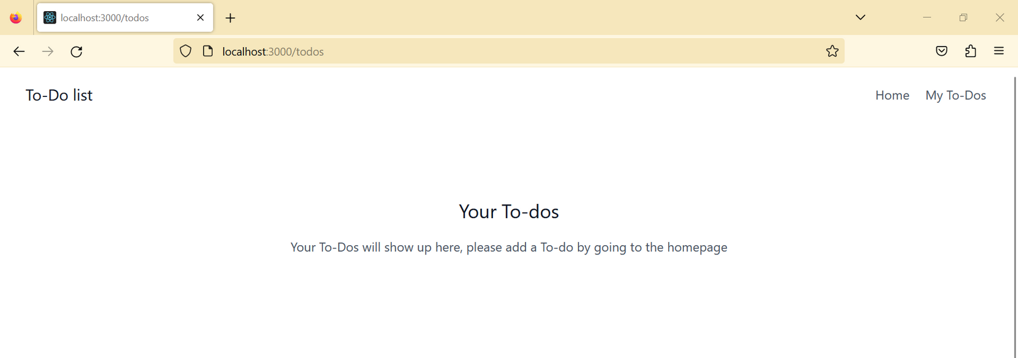
The user can then go to “My To-Dos” to view their todos
The my to-dos page will appear like this

Slide 5
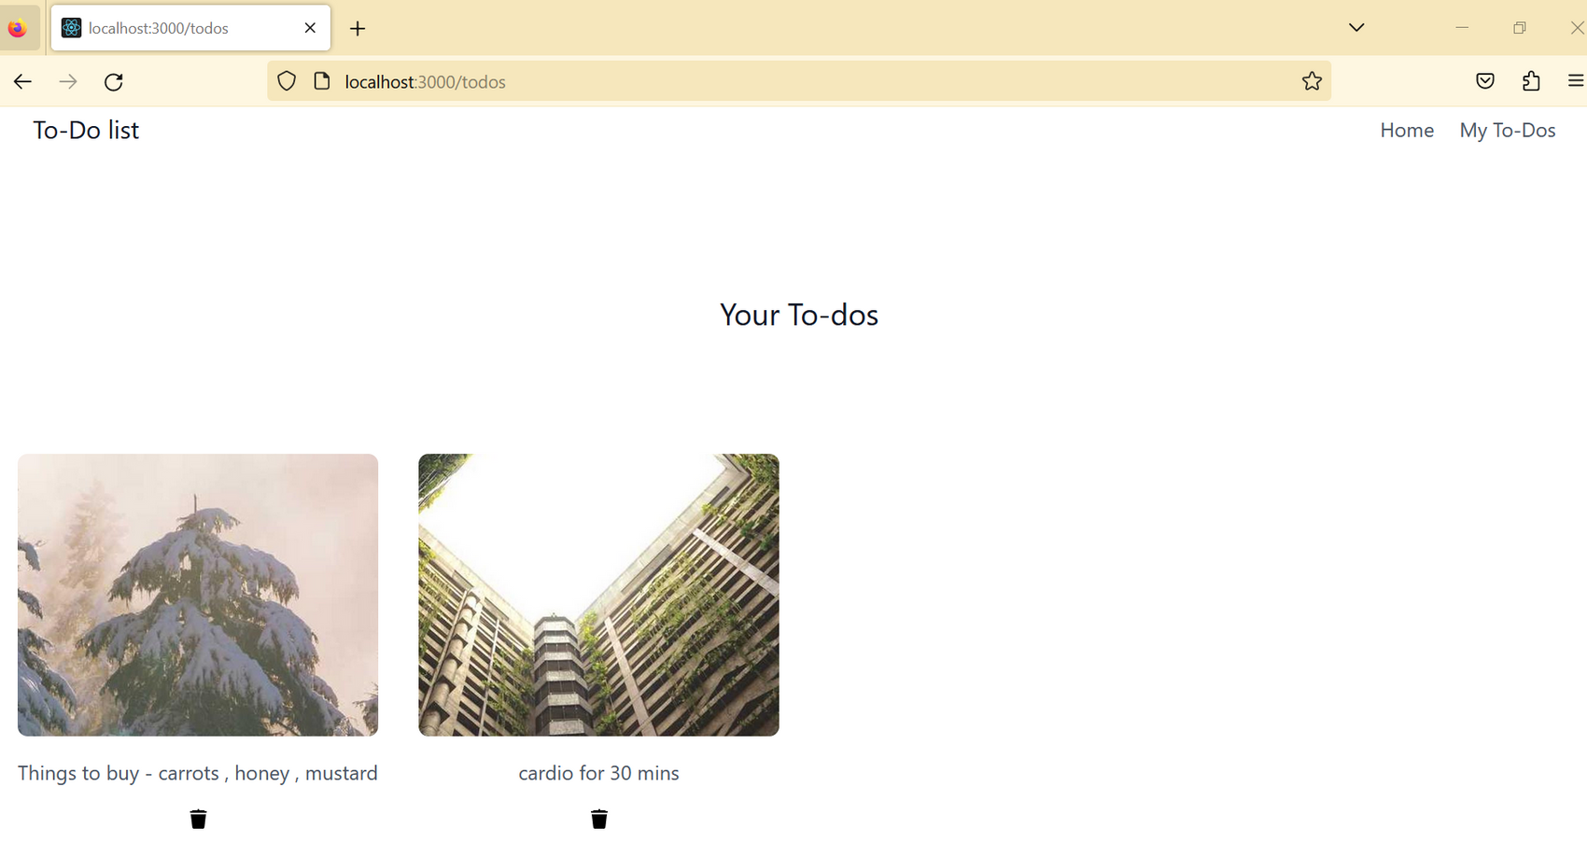
when the to-dos are added the page looks like this....each to-do has the option to be deleted

Slide 6
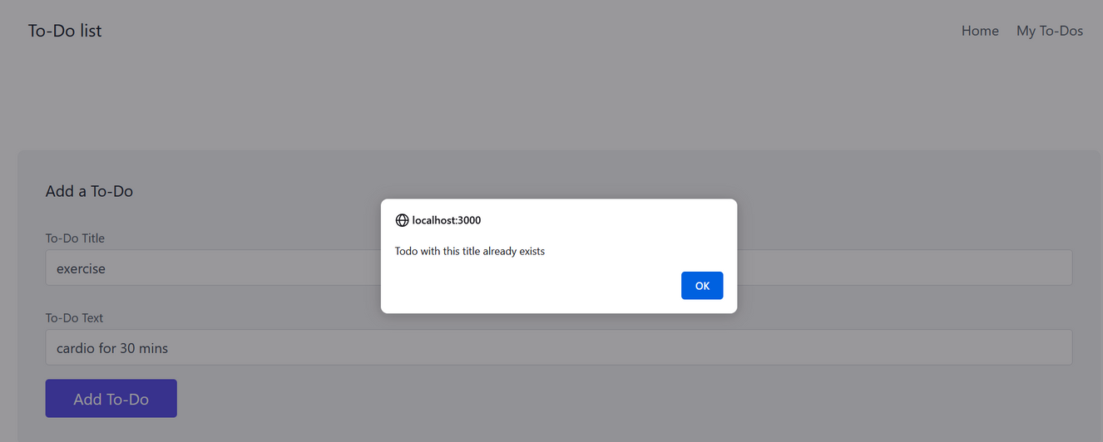
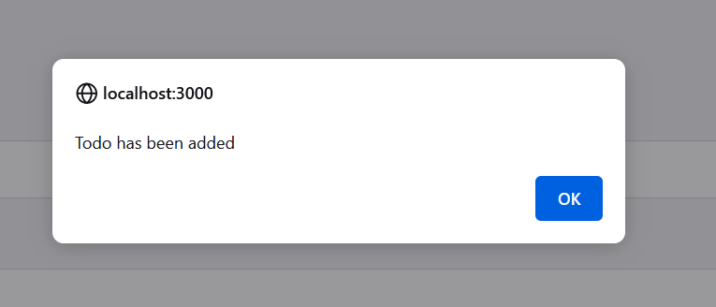
when u add a to-do it gives an alert stating that the todo has been added
when u add the same todo which is already present it gives an alert : todo with this title already exists
The delete button will help the user to delete any todo that they have already done or isnt required anymore

Slide 7


USES
Increases productivity
Provides motivation
Improves memory
ABOUT
76 %
The results show that people around the world are dependent with more than three-quarters (76 percent) of respondents currently keeping at least one list; some manage up to three or more lists concurrently.

Slide 8
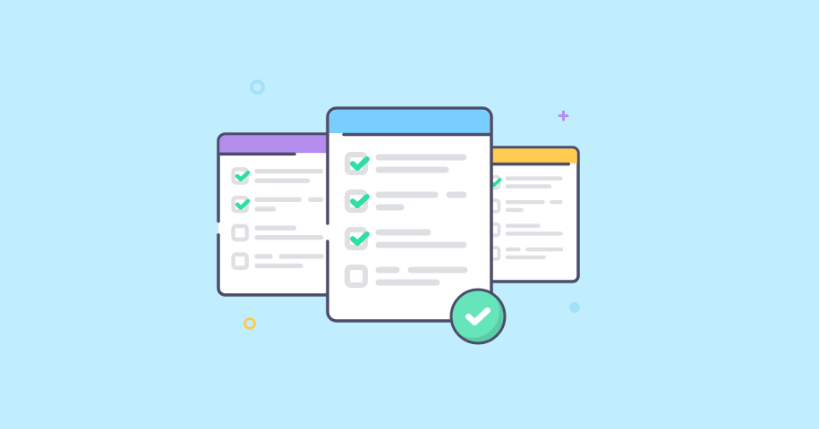
ADVANTAGES
DISADVANTAGES
Increases productivity.
Provides motivation.
Improves memory.
Reduces stress.
Allows for more personal time.
Reduces anxiety and improves mental health.
Provides a sense of accomplishment.
Set deadlines for each goal.
Decreased Confidence
Procrastination
Interruptions, Changes, Life Happening
Too Much To Do

Slide 9


FUTURE SCOPE
Having a list of everything you need to do written down in one place means you shouldn't forget anything important. By prioritising the tasks in the list you plan the order in which you're going to do them and can quickly see what needs your immediate attention and what tasks you can leave until a little later.

Slide 10


THANK YOU

